Slide 1



A Recap...
Many have been affected by physical disability
It can happen to anyone at anytime
Lot of frustrations when searching for accessible routes.
There were no great solutions at the moment until now..
Notes:
First point explain the stakeholders
Give quick recap

Slide 2

Ginsu E, Chris Y, Anna F, Mark L, Phuong V
Notes:
Introduce

Slide 3
Introducing Point2Point
Accessibility Map based mobile application
Indoor and Outdoor Map Modes
AR Implementation with the indoor maps
Accessible directions both inside and out
Notes:
Introduce our product and tie it into Bill’s story

Slide 4

Meet Bill!
Bill Johnson
73 years old
Four grandchildren
Seattle
Family man: caring and loving
Suffers from Rheumatoid Arthritis
“I want to always be there for my grandchildren and go eat my favorite food in the city.
Notes:
Intoduce our main guy

Slide 5
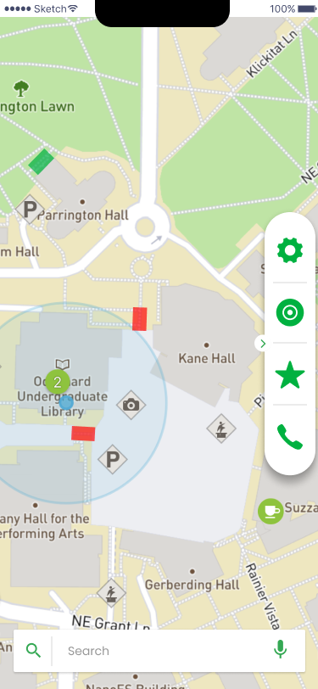
Home/Map Screen
Open up the app to find the Home Screen. From there, search where you want to go or tap a building and discover the accessible routes near you.

Slide 6
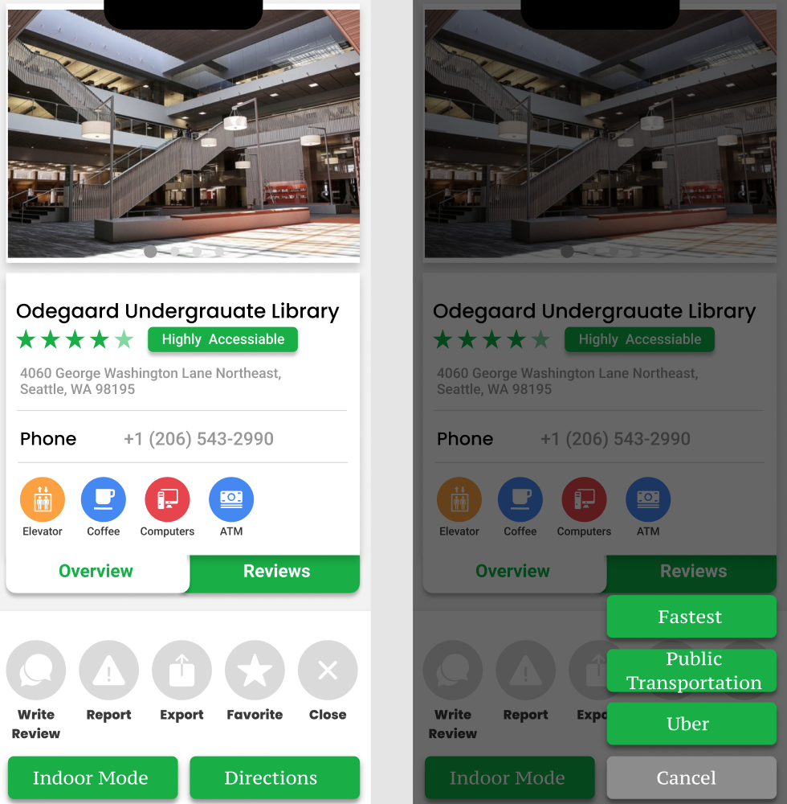
Information Screen
Find all necessary information here. From address and accessibility to helpful reviews from past visitors.

Slide 7
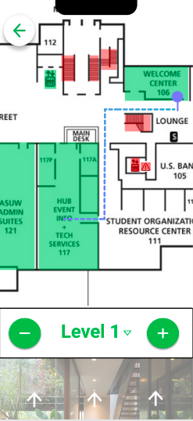
Indoor Direction Screen
Provide users with exact locations of where specific locations are in the building. Accessibilities in the building are labeled to show accessibility.

Slide 8
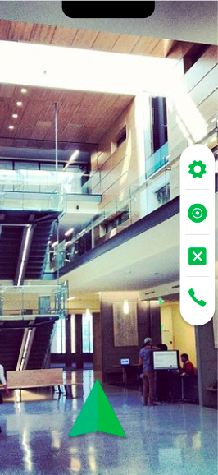
AR Mode
The navigation mode will allow users to navigate their surroundings using Augmented Reality with arrows to point the user in the correct direction.

